Slide 1
Customer Retention
Harshika Mahesh

Slide 2
Why Focus on customer Retention
Service encounter failures
Inconvenience
Pricing
Competition
Ethical Concern
Other Factors

Slide 3

Customer Retention Service India help to keep existing customer for lifetime and to encourage them to buy the products / brands.

Slide 4
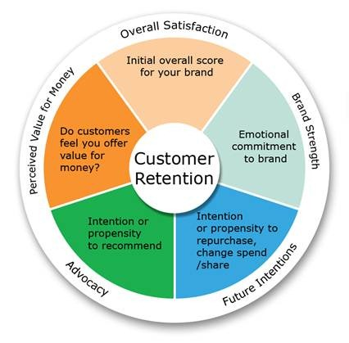
If the customer care representative call and know their feedback on the product , It will give good opinion to the customer since they think that the business care about they think of the business or products.

Slide 5

Why Is it Important ton retain Customer ?

Slide 6
The Main reason a Business venture is successful because customer make purchases
Is you want the customer to return or buy your product, retaining the regular customer and creating a steady customer base will help
By retaining customer, you can also obtain new clients.
This is best done by your customers’ advertising your products or services by word of mouth advertising .

Slide 7

Customer Advertising the product’s/ Business

Slide 8
Create and retain Goodwill by taking care of customers’ Individual demands
In the bushiness you can face competition from counterparts, but manage to retain loyal customers.
Training your employees to treat your customer with respect and care will promote customer retention.
Beyond paying attention to the customers’ need and offering pre- and post –sales services, it is crucial that you stay in touch with the customer regularly

Slide 9
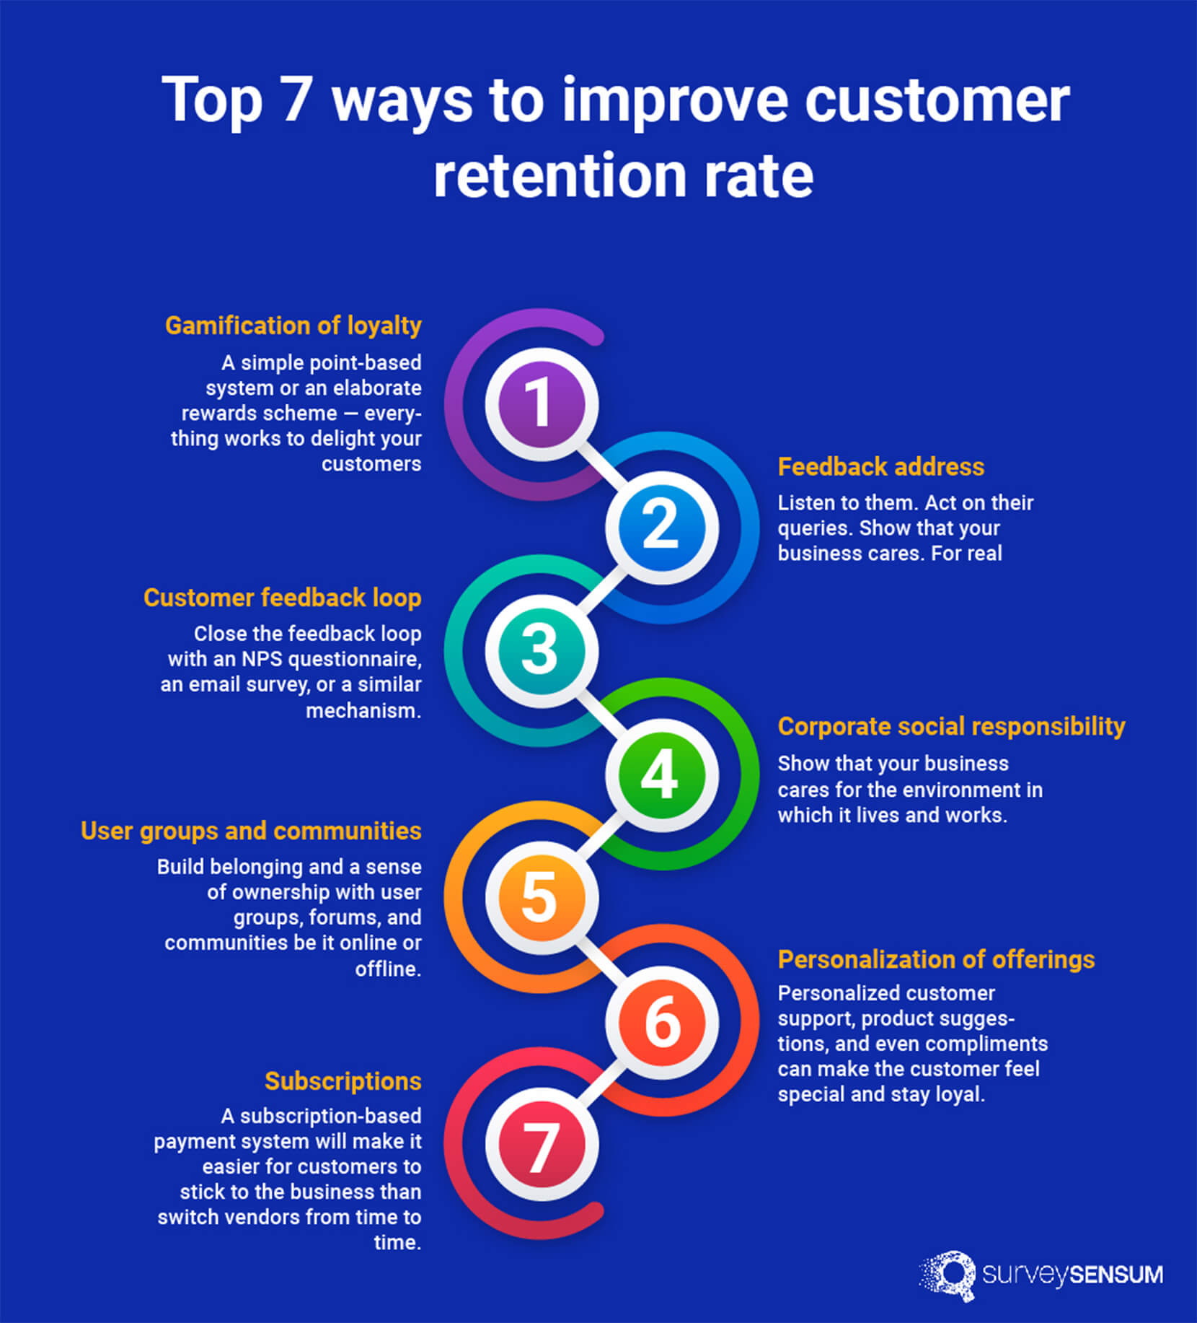
Customer Retention Process

Slide 10

Maintain and update customer Register
On occasion such as customers; birthday, anniversary , festivals etc.. Send handwritten note to them or call them personally.

Slide 11
Another factor that works in promoting customer retention – Location
If your Business place is located at an unheard of Zip Code, your customers will have great difficulty in getting to and from your shop .
This could result in you losing a few customer, making the distance a big and disadvantage to your business.

